Slide 1
Cornerstone City Church Peninsula Plus Community Hoo Are Ya
8th June 2025

Slide 2


Slide 3


Slide 4


Slide 5
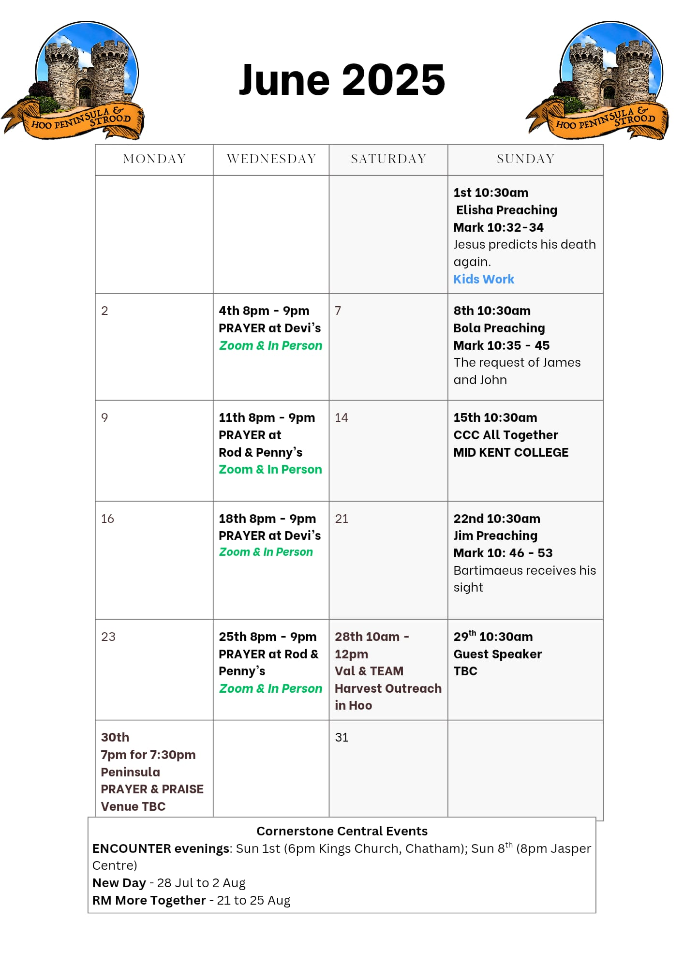

Slide 6

Grow Group 1
On YOUR MARK!

Slide 7
Leaders
Leaderss
Phil & Kim
Maria (Mia) Warren
Matthew Harrison
Richard & Elisha Acheampong
Phil & Kim
Maria (Mia) Warren
Matthew Harrison
Richard & Elisa Acheampong

Slide 8

Storm Walker
Storm Walker
Symbolising, trust in Jesus Christ through life's storms.
Mark 4:35-41

Slide 9


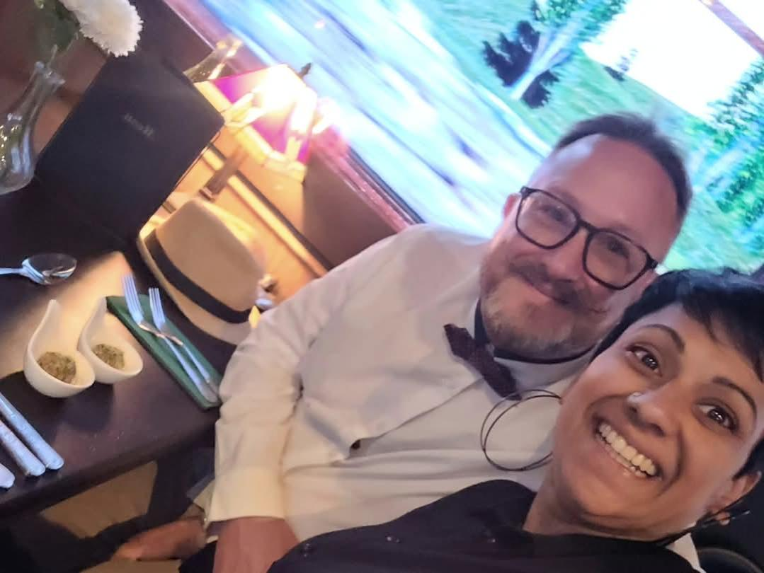
Group Leaders
Micheal and Mwamba
Wilfred and Parveen
Hannah

Slide 10


Slide 11


Slide 12


Slide 13
Graves Into Gardens
CCLI Song # 7138219
Brandon Lake | Chris Brown | Steven Furtick | Tiffany Hudson
© 2019 Music by Elevation Worship Publishing; Bethel Music Publishing; Brandon Lake Music; Maverick City Publishing Worldwide
For use solely with the SongSelect® Terms of Use. All rights reserved. www.ccli.com

Slide 14
1/10
I searched the world
But it couldn't fill me
Man's empty praise and treasures that fade
Are never enough

Slide 15
2/10
Then You came along and
Put me back together
And every desire is now satisfied
Here in Your love

Slide 16
3/10
Oh there's nothing better than You
There's nothing better than You
Lord there's nothing
Nothing is better than You

Slide 17
4/10
I'm not afraid to show You my weakness
My failures and flaws
Lord You've seen them all
And You still call me friend

Slide 18
5/10
'Cause the God of the mountain
Is the God of the valley
There's not a place
Your mercy and grace won't find me again

Slide 19
6/10
Oh there's nothing better than You
There's nothing better than You
Lord there's nothing
Nothing is better than You (REPEAT)

Slide 20
7/10
You turn mourning to dancing
You give beauty for ashes
You turn shame into glory
You're the only one who can
(REPEAT)

Slide 21
8/10
You turn graves into gardens
You turn bones into armies
You turn seas into highways
You're the only one who can
You're the only one who can

Slide 22
9/10
Oh there's nothing better than You
There's nothing better than You
Lord there's nothing
Nothing is better than You (REPEAT)

Slide 23
10/10
You turn graves into gardens
You turn bones into armies
You turn seas into highways
You're the only one who can
You're the only one who can

Slide 25
Trust In God
CCLI Song # 7206001
Brandon Lake | Chris Brown | Mitch Wong | Steven Furtick
© Brandon Lake Music; Music by Elevation Worship Publishing; A Wong Made Write Publishing; Integrity's Praise! Music
For use solely with the SongSelect® Terms of Use. All rights reserved. www.ccli.com
CCLI Licence No. 33265

Slide 26
1/8
Blessed assurance
Jesus is mine
He's been my fourth man in the fire
Time after time

Slide 27
2/8
Born of His Spirit
Washed in His blood
And what He did for me on Calvary
Is more than enough

Slide 28
3/8
I trust in God
My Savior, the One
Who will never fail
He will never fail

Slide 29
4/8
Perfect submission
All is at rest
I know the author of tomorrow
Has ordered my steps

Slide 30
5/8
So this is my story
And this is my song
I’m praising my risen King and Savior
All the day long

Slide 31
6/8
I trust in God
My Savior, the One
Who will never fail
He will never fail

Slide 32
7/8
I sought the Lord and
He heard and He answered
(X3)
That’s why I trust Him
That’s why (I trust Him)

Slide 33
8/8
I trust in God
My Savior, the One
Who will never fail
He will never fail

Slide 34
Firm Foundation (He Won't)
CCLI Song # 7188203
Austin Davis | Chandler Moore | Cody Carnes
© 2021 For Humans Publishing (Admin by Essential Music Publishing)
Maverick City Publishing (Admin by Essential Music Publishing)
Capitol CMG Paragon (Admin. by Capitol CMG Publishing)
TBCO Publishing (Admin. by Capitol CMG Publishing)
Writer's Roof Publishing (Admin. by Capitol CMG Publishing)
A.L.K.D. Music (Admin. by Watershed Music Group (Admin. by Capitol CMG Publishing))
For use solely with the SongSelect® Terms of Use. All rights reserved. www.ccli.com
CCLI Licence No. 33265

Slide 35
1/11
Christ is my firm foundation
The rock on which I stand
When everything around me is shaken
I've never been more glad

Slide 36
2/11
That I put my faith in Jesus
'Cause He's never let me down
He's faithful through generations
So why would He fail now

Slide 37
3/11
He won’t
He won't

Slide 38
4/11
I've still got joy in chaos
I've got peace that makes no sense
So I won't be going under
I'm not held by my own strength

Slide 39
5/11
'Cause I've built my life on Jesus
He's never let me down
He's faithful in every season
So why would He fail now

Slide 40
6/11
He won’t He won't
He won't fail
He won't fail

Slide 41
7/11
Rain came and wind blew
My house was built on You
I'm safe with You
I'm going to make it through

Slide 42
8/11
I'm going to make it through
‘Cause I’m standing strong on You
I’m going to make it through
‘Cause my house is built on You

Slide 43
9/11
Christ is my firm foundation
The rock on which I stand
When everything around me is shaken
I've never been more glad

Slide 44
10/11
That I put my faith in Jesus
'Cause He's never let me down
He's faithful through generations
So why would He fail now

Slide 45
11/11
He won’t He won't
He won't fail
He won't fail

Slide 46
1/2
And all the earth will shout Your praise
Our hearts will cry these bones will sing
Great are You Lord
(REPEAT)

Slide 47
2/2
It's Your breath in our lungs
So we pour out our praise
We pour out our praise
It's Your breath in our lungs
So we pour out our praise to You only

Slide 49
Servant King
CCLI Song # 78897
Graham Kendrick
© 1983 Thankyou Music
For use solely with the SongSelect® Terms of Use. All rights reserved. www.ccli.com
CCLI Licence No. 33265

Slide 50
1/8
From heav'n You came helpless babe
Enter'd our world Your glory veil'd
Not to be served but to serve
And give Your life that we might live

Slide 51
1/8
This is our God the Servant King
He calls us now to follow Him
To bring our lives as a daily offering
Of worship to the Servant King

Slide 52
3/8
There in the garden of tears
My heavy load He chose to bear
His heart with sorrow was torn
Yet not my will but Yours He said

Slide 53
4/8
This is our God the Servant King
He calls us now to follow Him
To bring our lives as a daily offering
Of worship to the Servant King

Slide 54
5/8
Come see His hands and His feet
The scars that speak of sacrifice
Hands that flung stars into space
To cruel nails
Surrendered

Slide 55
6/8
This is our God the Servant King
He calls us now to follow Him
To bring our lives as a daily offering
Of worship to the Servant King

Slide 56
7/8
So let us learn how to serve
And in our lives enthrone Him
Each other's needs to prefer
For it is Christ we're serving

Slide 57
8/8
This is our God the Servant King
He calls us now to follow Him
To bring our lives as a daily offering
Of worship to the Servant King

Slide 58


Slide 59
2 Corinthians 14 May the grace of the Lord Jesus Christ, and the love of God, and the fellowship of the Holy Spirit be with you all
Surely goodness and mercy shall follow me all the days of my life, and I shall dwell in the house of the Lord forever.

